Slide 1
Hypothesis Testing
Chapter 9 (9.1 - 9.3)
.
Chap 9-<number>

Slide 2
Learning Objectives
In this chapter, you learn:
The basic principles of hypothesis testing
How to test population means
Required assumptions
How to read and interpret results of hypothesis testing
.
Chap 9-<number>

Slide 3

What is a Hypothesis?
A hypothesis is a claim
(assertion) about a
population parameter:
  population mean
  population proportion
Example: The mean monthly cell phone bill in this city is μ = $42
Example: The proportion of adults in this city with cell phones is π = 0.68
.
Chap 9-<number>

Slide 4
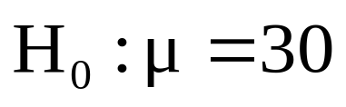
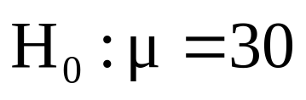
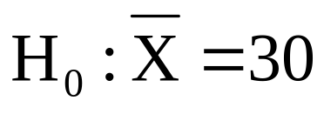

The Null Hypothesis, H₀
States the claim or assertion to be tested
  Example: The mean diameter of a manufactured bolt is 30mm ( )
Is always about a population parameter, not about a sample statistic
.
Chap 9-<number>

Slide 5

The Null Hypothesis, H₀
(continued)
Begin with the assumption that the null hypothesis is true
  Similar to the notion of innocent until
  proven guilty
Refers to the status quo or historical value
Always contains “=“, or “≤”, or “≥” sign
May or may not be rejected, according to the test results
.
Chap 9-<number>

Slide 6
The Alternative Hypothesis, H₁
Is the opposite of the null hypothesis
  e.g., The average diameter of a manufactured bolt is not equal to 30mm ( H₁: μ ≠ 30 )
Challenges the status quo
Contains “≠“, or “<”, or “>” sign
May be supported or not supported by evidence that comes from data
.
Chap 9-<number>

Slide 7
The Hypothesis Testing Process
Claim: The population mean age is 50.
  H₀: μ = 50, H₁: μ ≠ 50
Sample the population and find sample mean.
Population
Sample
.
Chap 9-<number>

Slide 8
The Hypothesis Testing Process
(continued)
Suppose the sample mean age was X = 20.
This is significantly lower than the claimed mean population age of 50.
If the null hypothesis were true, the probability of getting such a different sample mean would be very small, so you reject the null hypothesis .
In other words, getting a sample mean of 20 is so unlikely if the population mean was 50, you conclude that the population mean must not be 50.
.
Chap 9-<number>

Slide 9
The Hypothesis Testing Process
(continued)
Sampling Distribution of X
X
20
μ = 50
If H₀ is true
... then you reject the null hypothesis that μ = 50.
If it is unlikely that you would get a sample mean of this value ...
... When in fact this were
the population mean…
.
Chap 9-<number>

Slide 10
The Test Statistic and
Critical Values
If the sample mean is close to the stated population mean, the null hypothesis is not rejected.
If the sample mean is far from the stated population mean, the null hypothesis is rejected.
How far is “far enough” to reject H₀?
The critical value of a test statistic creates a “line in the sand” for decision making -- it answers the question of how far is far enough.
.
Chap 9-<number>

Slide 11
The Test Statistic and
Critical Values
Sampling Distribution of the test statistic
Region of Rejection
Region of Rejection
Region of
Non-Rejection
Critical Values
“Too Far Away” From Mean of Sampling Distribution
.
Chap 9-<number>

Slide 12
Possible Errors in Hypothesis Test Decision Making
Type I Error
  Reject a true null hypothesis
  Considered a serious type of error
  We control the probability of a Type I Error at α
    Called level of significance of the test
    Set by researcher in advance
Type II Error
  Failure to reject a false null hypothesis
  The probability of a Type II Error is β
  We try to minimize β while guaranteeing
  the given α
.
Chap 9-<number>

Slide 13
Possible Errors in Hypothesis Test Decision Making
(continued)
Possible Hypothesis Test Outcomes
 | Actual Situation
Decision | H₀ True | H₀ False
Do Not Reject H₀ | No Error Probability 1 - α | Type II Error Probability β
Reject H₀ | Type I Error Probability α | No Error Power 1 - β
.
Chap 9-<number>

Slide 14
Possible Errors in Hypothesis Test Decision Making
(continued)
The confidence coefficient (1-α) is the probability of not rejecting H₀ when it is true.
The power of a statistical test (1-β) is the probability of rejecting H₀ when it is false.
.
Chap 9-<number>

Slide 15
Level of Significance and the Rejection Region
H₀: μ = 30 H₁: μ ≠ 30
Level of significance =
α
α
α
/2
/2
30
Critical values
Rejection Region
This is a two-tail test because there is a rejection region in both tails
.
Chap 9-<number>

Slide 16
Examples
## 9.10, 9.11 on p. 317
.
Chap 9-<number>

Slide 17
Hypothesis Tests for the Mean
Hypothesis
Tests for μ
σ Known
σ Unknown
(Z test)
(t test)
.
Chap 9-<number>

Slide 18
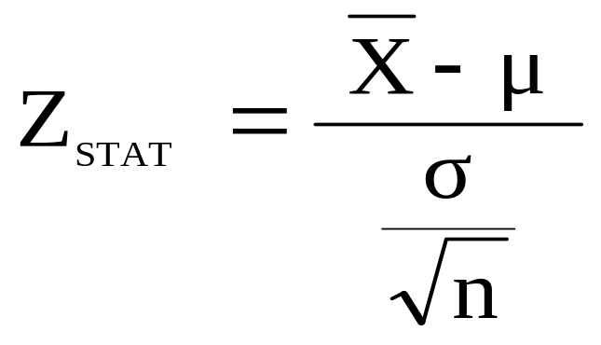
Z Test of Hypothesis for the Mean (σ Known)
Convert sample statistic ( ) to a Z_{STAT} test statistic
X
Hypothesis
Tests for μ
σ Known
σ Known
σ Unknown
σ Unknown
(Z test)
(t test)
The test statistic is:
.
Chap 9-<number>

Slide 19

Critical Value
Approach to Testing
For a two-tail test for the mean, σ known:
Convert sample statistic ( ) to test statistic (Z_{STAT})
Determine the critical Z values for a specified
level of significance α from a table or computer
Decision Rule: If the test statistic falls in the rejection region, reject H₀ ; otherwise do not reject H₀
.
Chap 9-<number>

Slide 20
Two-Tail Tests
H₀: μ = 30 H₁: μ ≠ 30
There are two cutoff values (critical values), defining the regions of rejection
α/2
α/2
30
X
Reject H₀
Do not reject H₀
Reject H₀
-Z_{α/2}
+Z_{α/2}
Z
0
Lower critical value
Upper critical value
.
Chap 9-<number>

Slide 21
6 Steps in
Hypothesis Testing
State the null hypothesis, H₀ and the alternative hypothesis, H₁
Choose the level of significance, α, and the sample size, n
Determine the appropriate test statistic and sampling distribution
Determine the critical values that divide the rejection and non-rejection (acceptance) regions
.
Chap 9-<number>

Slide 22
6 Steps in
Hypothesis Testing
(continued)
Collect data and compute the value of the test statistic
Make the statistical decision and state the managerial conclusion. If the test statistic falls into the non-rejection region, do not reject the null hypothesis H₀. If the test statistic falls into the rejection region, reject the null hypothesis. It means the data provides significant evidence, at level α, to reject H₀ in favor of H₁. Express the managerial conclusion in the context of the problem
.
Chap 9-<number>

Slide 23
Hypothesis Testing Example
Test the claim that the true mean diameter of a manufactured bolt is 30 mm.
(Assume σ = 0.8)
1. State the appropriate null and alternative hypotheses
  H₀: μ = 30 H₁: μ ≠ 30 (This is a two-tail test)
2. Specify the level of significance and the sample size
  Suppose that α = 0.05 and n = 100 are chosen for this test
.
Chap 9-<number>

Slide 24
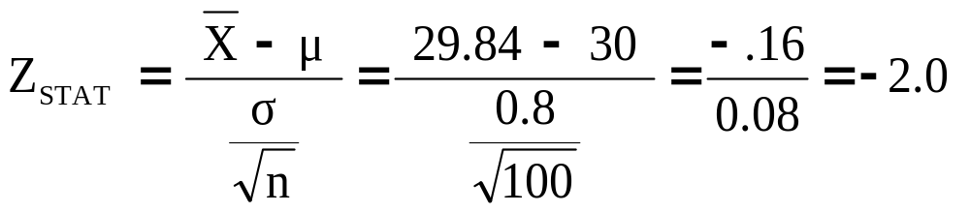
Hypothesis Testing Example
(continued)
3. Determine the appropriate technique
  σ is assumed known so this is a Z test.
4. Determine the critical values
  For α = 0.05 the critical Z values are ±1.96
5. Collect the data and compute the test statistic
  Suppose the sample results are
  n = 100, X = 29.84 (σ = 0.8 is assumed known)
  So the test statistic is:
.
Chap 9-<number>

Slide 25
Hypothesis Testing Example
(continued)
6. Is the test statistic in the rejection region?
α/2 = 0.025
α/2 = 0.025
Reject H₀ if Z_{STAT} < -1.96 or Z_{STAT} > 1.96; otherwise do not reject H₀
Reject H₀
Do not reject H₀
Reject H₀
-Z_{α/2} = -1.96
0
+Z_{α/2} = +1.96
Here, Z_{STAT} = -2.0 < -1.96, so the test statistic is in the rejection region
.
Chap 9-<number>

Slide 26
Hypothesis Testing Example
(continued)
6 (continued). Reach a decision and interpret the result
α = 0.05/2
α = 0.05/2
Reject H₀
Do not reject H₀
Reject H₀
-Z_{α/2} = -1.96
0
+Z_{α/2}= +1.96
-2.0
Since Z_{STAT} = -2.0 < -1.96, reject the null hypothesis and conclude there is sufficient evidence that the mean diameter of a manufactured bolt is not equal to 30
.
Chap 9-<number>

Slide 27
Examples
## 9.14a on p. 317
.
Chap 9-<number>

Slide 28
p-Value Approach to Testing
p-value: Probability of obtaining a test statistic equal to or more extreme than the observed sample value given H₀ is true
  The p-value is also called the observed level of significance
  It is the smallest value of α for which H₀ can be rejected
.
Chap 9-<number>

Slide 29
p-Value Approach to Testing:
Interpreting the p-value
Compare the p-value with α
  If p-value < α , reject H₀
  If p-value ≥ α , do not reject H₀
Remember
  If the p-value is low then H₀ must go
.
Chap 9-<number>

Slide 30
The 5 Step p-value approach to
Hypothesis Testing
State the null hypothesis, H₀ and the alternative hypothesis, H₁
Choose the level of significance, α, and the sample size, n
Determine the appropriate test statistic and sampling distribution
Collect data and compute the value of the test statistic and the p-value
Make the statistical decision and state the managerial conclusion. If the p-value is < α then reject H₀, otherwise do not reject H₀. State the managerial conclusion in the context of the problem
.
Chap 9-<number>

Slide 31
p-value Hypothesis Testing Example
Test the claim that the true mean diameter of a manufactured bolt is 30mm.
(Assume σ = 0.8)
1. State the appropriate null and alternative
hypotheses
  H₀: μ = 30 H₁: μ ≠ 30 (This is a two-tail test)
2. Specify the desired level of significance and the sample size
  Suppose that α = 0.05 and n = 100 are chosen for this test
.
Chap 9-<number>

Slide 32
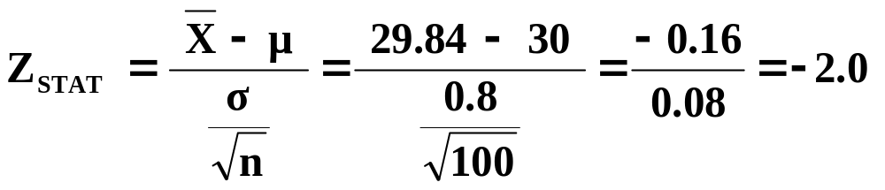
p-value Hypothesis Testing Example
(continued)
3. Determine the appropriate technique
  σ is assumed known so this is a Z test.
4. Collect the data, compute the test statistic and the p-value
  Suppose the sample results are
  n = 100, X = 29.84 (σ = 0.8 is assumed known)
  So the test statistic is:
.
Chap 9-<number>

Slide 33
p-Value Hypothesis Testing Example:
Calculating the p-value
4. (continued) Calculate the p-value.
  How likely is it to get a Z_{STAT} of -2 (or something further from the mean (0), in either direction) if H₀ is true?
P(Z < -2.0) = 0.0228
P(Z > 2.0) = 0.0228
0
Z
-2.0
2.0
p-value = 0.0228 + 0.0228 = 0.0456
.
Chap 9-<number>

Slide 34
p-value Hypothesis Testing Example
(continued)
5. Is the p-value < α?
  Since p-value = 0.0456 < α = 0.05 Reject H₀
5. (continued) State the managerial conclusion in the context of the situation.
  There is sufficient evidence to conclude the average diameter of a manufactured bolt is not equal to 30mm.
.
Chap 9-<number>

Slide 35
Examples
## 9.14b on p. 317
.
Chap 9-<number>

Slide 36
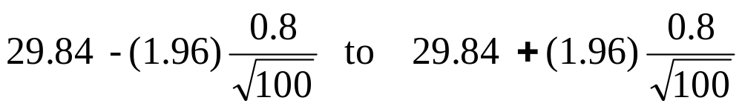
Connection Between Two-Tail Tests and Confidence Intervals
For X = 29.84, σ = 0.8 and n = 100, the 95% confidence interval is:
29.6832 ≤ μ ≤ 29.9968
Since this interval does not contain the hypothesized mean (30), we reject the null hypothesis at α = 0.05
.

Slide 37
Example
## 9.14c on p. 317
.
Chap 9-<number>

Slide 38
Hypothesis Testing: σ Unknown
If the population standard deviation is unknown, you instead use the sample standard deviation S.
Because of this change, you use the t distribution instead of the Z distribution to test the null hypothesis about the mean.
When using the t distribution you must assume the population you are sampling from follows a normal distribution.
All other steps, concepts, and conclusions are the same.
.
Chap 9-<number>

Slide 39
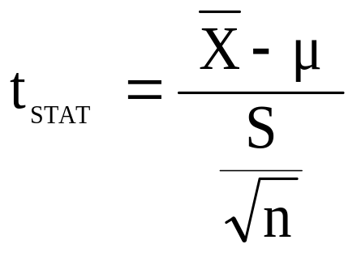
t Test of Hypothesis for the Mean (σ Unknown)
Convert sample statistic ( ) to a t_{STAT} test statistic
X
Hypothesis
Tests for μ
Hypothesis
Tests for μ
Hypothesis
Tests for μ
σ Known
σ Known
σ Known
σ Known
σ Known
σ Known
σ Unknown
σ Unknown
σ Unknown
σ Unknown
σ Unknown
σ Unknown
(Z test)
(Z test)
(Z test)
(t test)
(t test)
(t test)
The test statistic is:
The test statistic is:
The test statistic is:
.
Chap 9-<number>

Slide 40

Example: Two-Tail Test
(σ Unknown)
The average cost of a hotel room in New York is said to be $168 per night. To determine if this is true, a random sample of 25 hotels is taken and resulted in an X of $172.50 and an S of $15.40. Test the appropriate hypotheses at α = 0.05.
(Assume the population distribution is normal)
H₀: μ = 168 H₁: μ ≠ 168
.
Chap 9-<number>

Slide 41
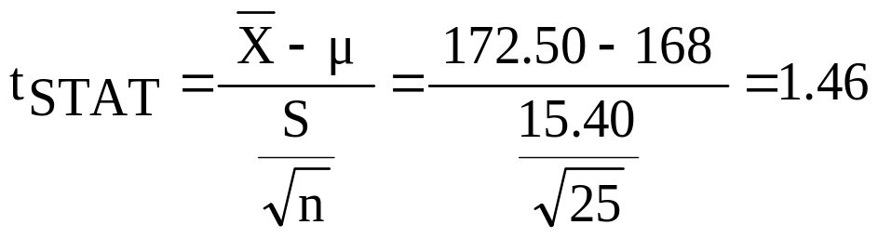
Example Solution:
Two-Tail t Test
H₀: μ = 168 H₁: μ ≠ 168
α/2=.025
α/2=.025
α = 0.05
n = 25, df = 25-1=24
σ is unknown, so
use a t statistic
Critical Value:
±t_{24,0.025} = ± 2.0639
Reject H₀
Do not reject H₀
Reject H₀
-t _{24,0.025}
t _{24,0.025}
0
-2.0639
2.0639
1.46
Do not reject H₀: insufficient evidence that true mean cost is different from $168
.
Chap 9-<number>

Slide 42
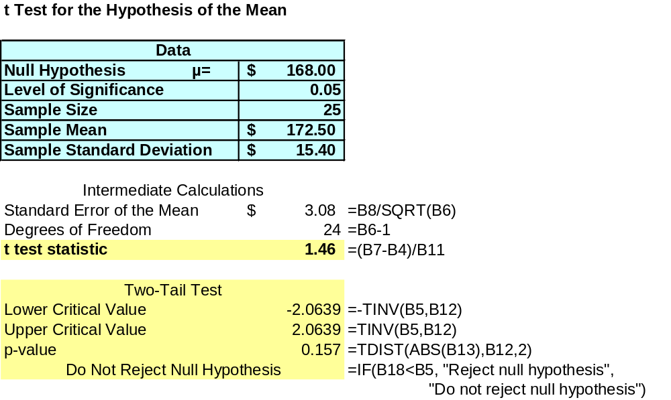
Example Two-Tail t Test Using A p-value from Excel
Since this is a t-test we cannot calculate the p-value without some calculation aid.
The Excel output below does this:
p-value > α
So do not reject H₀
.
Chap 9-<number>

Slide 43


Connection of Two Tail Tests to Confidence Intervals
For X = 172.5, S = 15.40 and n = 25, the 95% confidence interval for µ is:
172.5 - (2.0639) 15.4/ 25 to 172.5 + (2.0639) 15.4/ 25
166.14 ≤ μ ≤ 178.86
Since this interval contains the Hypothesized mean (168), we do not reject the null hypothesis at α = 0.05
.

Slide 44
Example
## 9.32 on p. 323
.
Chap 9-<number>

Slide 45
One-Tail Tests
In many cases, the alternative hypothesis focuses on a particular direction
This is a lower-tail test since the alternative hypothesis is focused on the lower tail below the mean of 3
H₀: μ ≥ 3
H₁: μ < 3
H₀: μ ≤ 3
H₁: μ > 3
This is an upper-tail test since the alternative hypothesis is focused on the upper tail above the mean of 3
.
Chap 9-<number>

Slide 46
Lower-Tail Tests
H₀: μ ≥ 3
H₁: μ < 3
There is only one critical value, since the rejection area is in only one tail
Use α instead of α/2
α
Reject H₀
Do not reject H₀
Z or t
-Z_{α} or -t_{α}
0
μ
X
Critical value
.
Chap 9-<number>

Slide 47
Upper-Tail Tests
H₀: μ ≤ 3
H₁: μ > 3
There is only one critical value, since the rejection area is in only one tail
α
Z or t
Do not reject H₀
Reject H₀
0
Z_{α} or t_{α}
_
X
μ
Critical value
.
Chap 9-<number>

Slide 48
Example: Upper-Tail t Test for Mean (σ unknown)
A phone industry manager thinks that customer monthly cell phone bills have increased, and now average over $52 per month. The company wishes to test this claim. (Assume a normal population)
Form hypothesis test:
H₀: μ ≤ 52 the average is not over $52 per month
H₁: μ > 52 the average is greater than $52 per month
(i.e., sufficient evidence exists to support the
manager’s claim)
.
Chap 9-<number>

Slide 49
Example: Find Rejection Region
(continued)
Suppose that α = 0.10 is chosen for this test and n = 25.
Find the rejection region:
Reject H₀
α = 0.10
Do not reject H₀
Reject H₀
0
1.318
Reject H₀ if t_{STAT} > 1.318
.
Chap 9-<number>

Slide 50
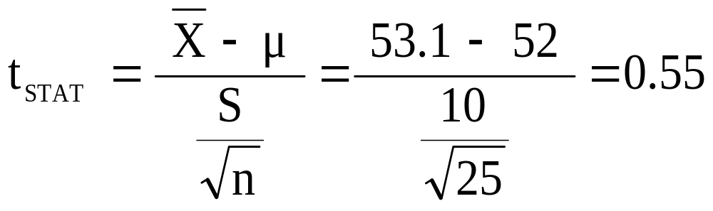
Example: Test Statistic
(continued)
Obtain sample and compute the test statistic
Suppose a sample is taken with the following results: n = 25, X = 53.1, and S = 10
  Then the test statistic is:
.
Chap 9-<number>

Slide 51
Example: Decision
(continued)
Reach a decision and interpret the result:
Reject H₀
α = 0.10
Do not reject H₀
1.318
Reject H₀
0
t_{STAT} = 0.55
Do not reject H₀ since t_{STAT} = 0.55 ≤ 1.318
there is not sufficient evidence that the
mean bill is over $52
.
Chap 9-<number>

Slide 52
Example: Utilizing The p-value for The Test
Calculate the p-value and compare to α (p-value below calculated using excel spreadsheet on next page)
p-value = .2937
Reject H₀
α = .10
0
Do not reject H₀
1.318
Reject H₀
t_{STAT} = .55
Do not reject H₀ since p-value = .2937 > α = .10
.
Chap 9-<number>

Slide 53
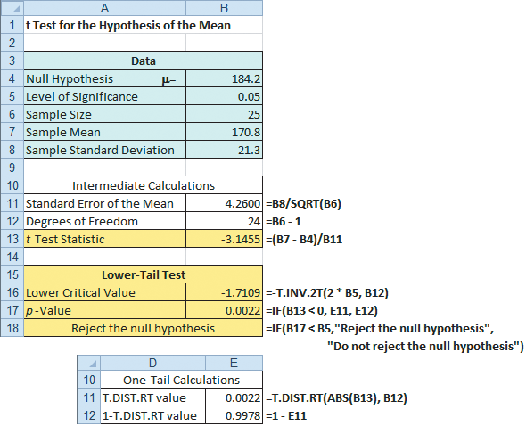
Excel Spreadsheet Calculating The p-value for An Upper Tail t Test
.
Chap 9-<number>

Slide 54
Example
## 9.50 on p. 328
.
Chap 9-<number>

